Slide 1
Big Mountain Resort
What ticket price will maximize profit during
the next ski /snowboard season?

Slide 2
Executive Recommendation 1
Increase the ticket price because the resort seems to be underpriced.
  Currently charges $81.00
  Could charge $95.87 based on the facilities
  Even with expected mean absolute error of $10.39, this still suggests a price increase

Slide 3
Executive Recommendation 2
Adding a run, which increases the vertical drop by 150 feet, and installing an additional chair lift has a positive expected value.
  Increases support for ticket price by $1.99
  Over the season, this could be expected to amount to $3,474,638

Slide 4
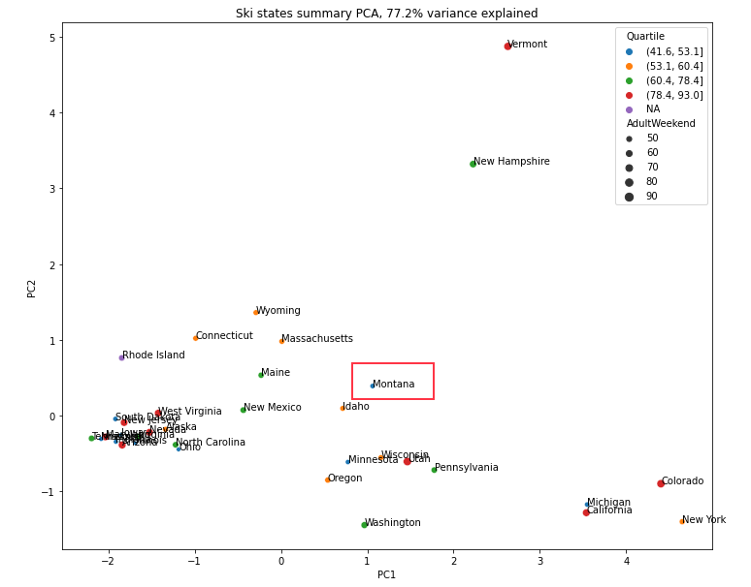

Slide 5
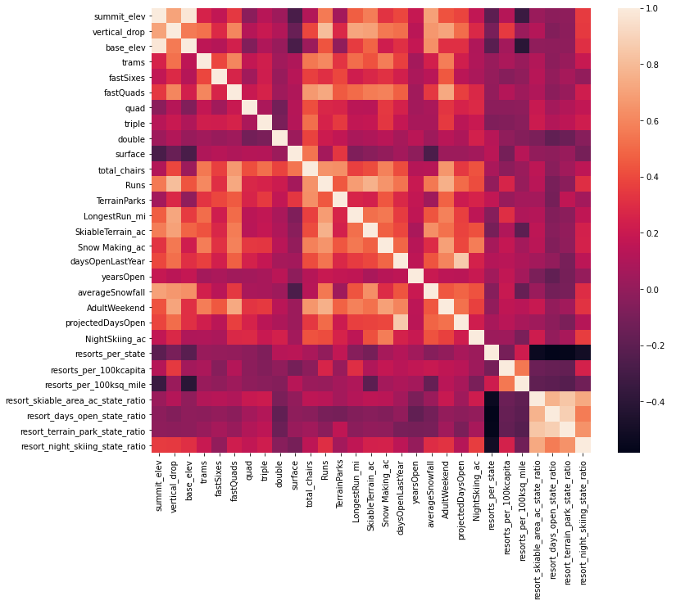
Heatmap
Fast Quads
Runs
Snow Making Acres
Vertical Drop
Total Drop
Resort Night Skiing

Slide 6
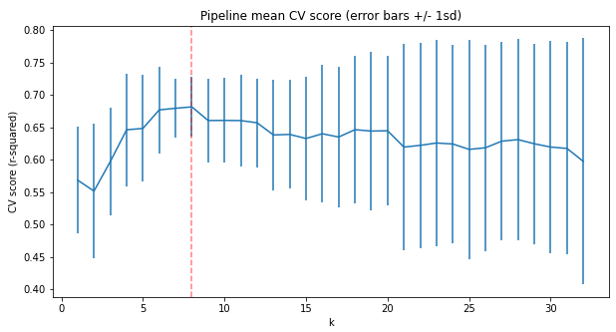
Linear Model found 8 features to be best
Vertical Drop = 10.767857
Snow Making = 6.290074
Total Chairs = 5.794156
Fast Quads = 5.745626
Runs = 5.370555
Longest Run Mile = 0.181814
Trams = -4.142024
Skiable Terrain = -5.249780

Slide 7
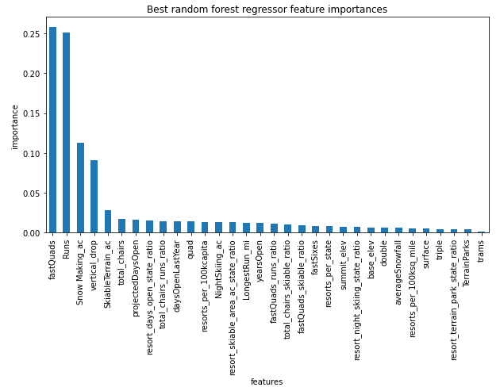
Random Forest
Fast Quads
Runs
Snow Making Acres
Vertical Drop

Slide 8
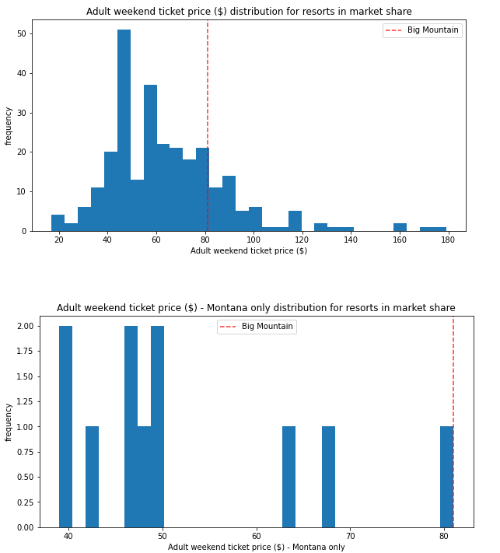
Adult Weekend Price Distribution Comparisons

Slide 9
Summary
An increased ticket price of $4.48 or more is justified based on the facilities Big Mountain Resort currently provides.
Questions?

